Slide 1

Welcome to Our Presentation

Slide 2
Our Presentation Topic
Decorate a Room
By
Open GL

Slide 3
Our Group Members
1
Md. Shariful Islam 142-15-4157
2
Md. Kiron Ali 142-15-4085

Slide 4
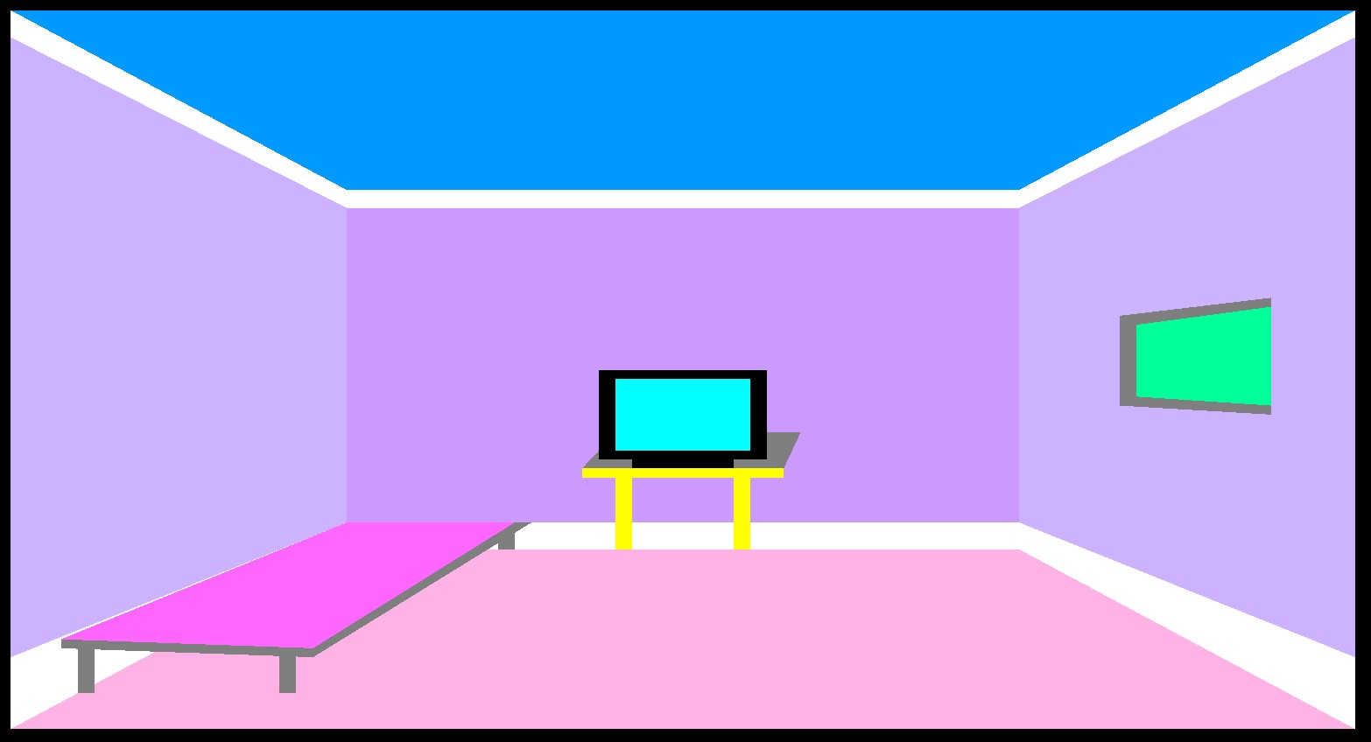
Project Screenshot

Slide 5
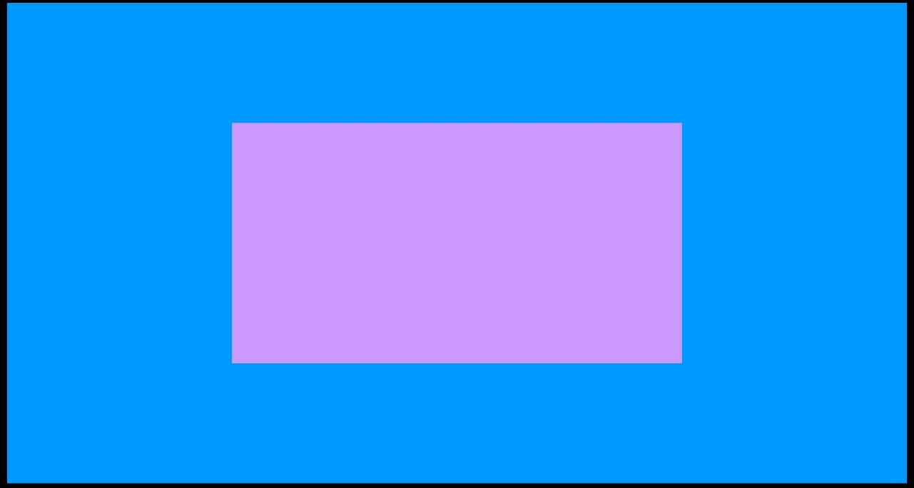
Code and Preview
/* Middle Wall*/
glColor3f (0.80, 0.60, 1.0);
glBegin(GL_POLYGON);
glVertex3f (0.30, 0.30, 0.0);
glVertex3f (0.70, 0.30, 0.0);
glVertex3f (0.70, 0.70, 0.0);
glVertex3f (0.30, 0.70, 0.0);
glEnd();

Slide 6
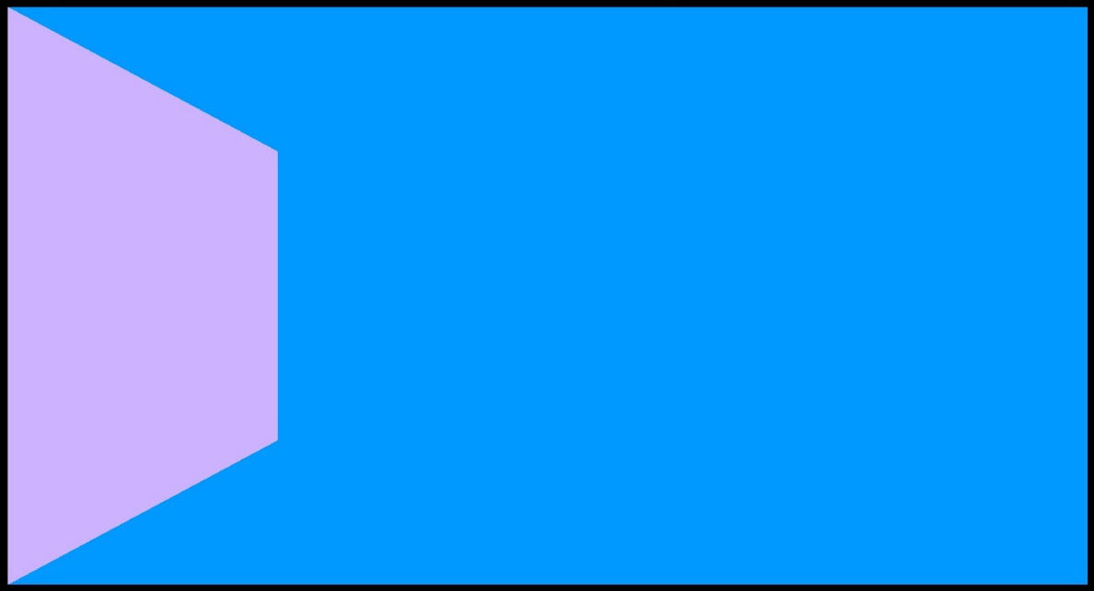
Code and Preview
/* Left Wall*/
glColor3f (0.80, 0.70, 1.0);
glBegin(GL_POLYGON);
glVertex3f (0.10, 0.10, 0.0);
glVertex3f (0.30, 0.30, 0.0);
glVertex3f (0.30, 0.70, 0.0);
glVertex3f (0.10, 0.90, 0.0);
glEnd();

Slide 7

Code and Preview
/* Right Wall*/
glColor3f (0.80, 0.70, 1.0);
glBegin(GL_POLYGON);
glVertex3f (0.70, 0.30, 0.0);
glVertex3f (0.90, 0.10, 0.0);
glVertex3f (0.90, 0.90, 0.0);
glVertex3f (0.70, 0.70, 0.0);
glEnd();

Slide 8
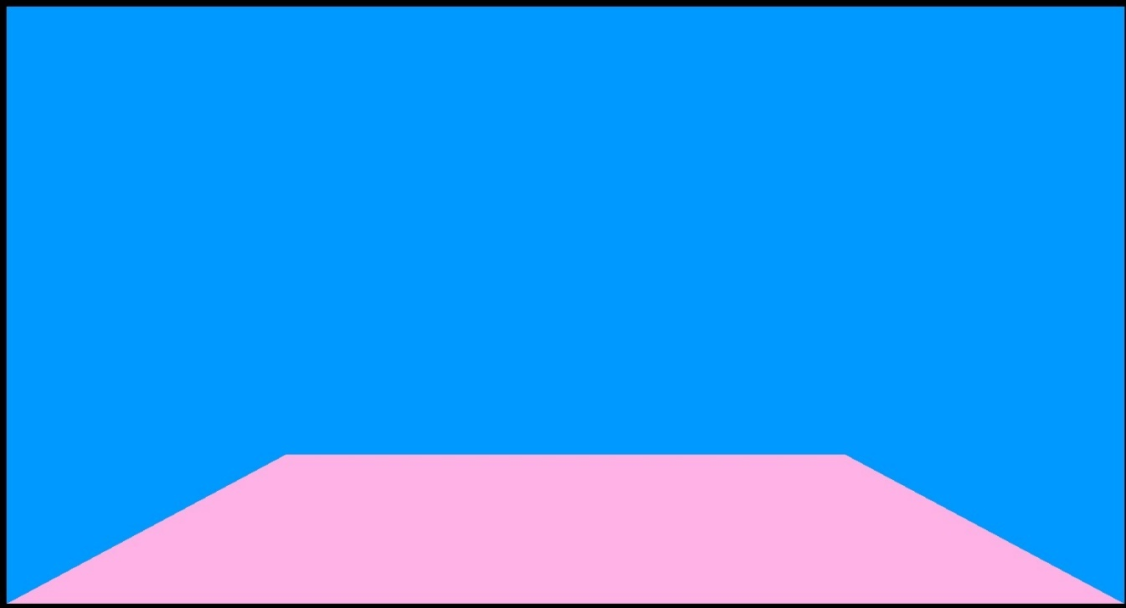
Code and Preview
/* Flor */
glColor3f(1.0f,0.70,0.90);
glBegin(GL_POLYGON);
glVertex3f (0.10, 0.10, 0.0);
glVertex3f (0.90, 0.10, 0.0);
glVertex3f (0.70, 0.30, 0.0);
glVertex3f (0.30, 0.30, 0.0);
glEnd();

Slide 9
Code For Border Top
/* Border Start Top*/
glColor3f (1.0, 1.0, 1.0);
glBegin(GL_POLYGON);
glVertex3f (0.10, 0.87, 0.0);
glVertex3f (0.30, 0.68, 0.0);
glVertex3f (0.30, 0.70, 0.0);
glVertex3f (0.10, 0.90, 0.0);
glEnd();
glColor3f (1.0, 1.0, 1.0);
glBegin(GL_POLYGON);
glVertex3f (0.30, 0.68, 0.0);
glVertex3f (0.70, 0.68, 0.0);
glVertex3f (0.70, 0.70, 0.0);
glVertex3f (0.30, 0.70, 0.0);
glEnd();
glColor3f (1.0, 1.0, 1.0);
glBegin(GL_POLYGON);
glVertex3f (0.70, 0.68, 0.0);
glVertex3f (0.90, 0.87, 0.0);
glVertex3f (0.90, 0.90, 0.0);
glVertex3f (0.70, 0.70, 0.0);
glEnd();
/* Border Start Top End*/

Slide 10
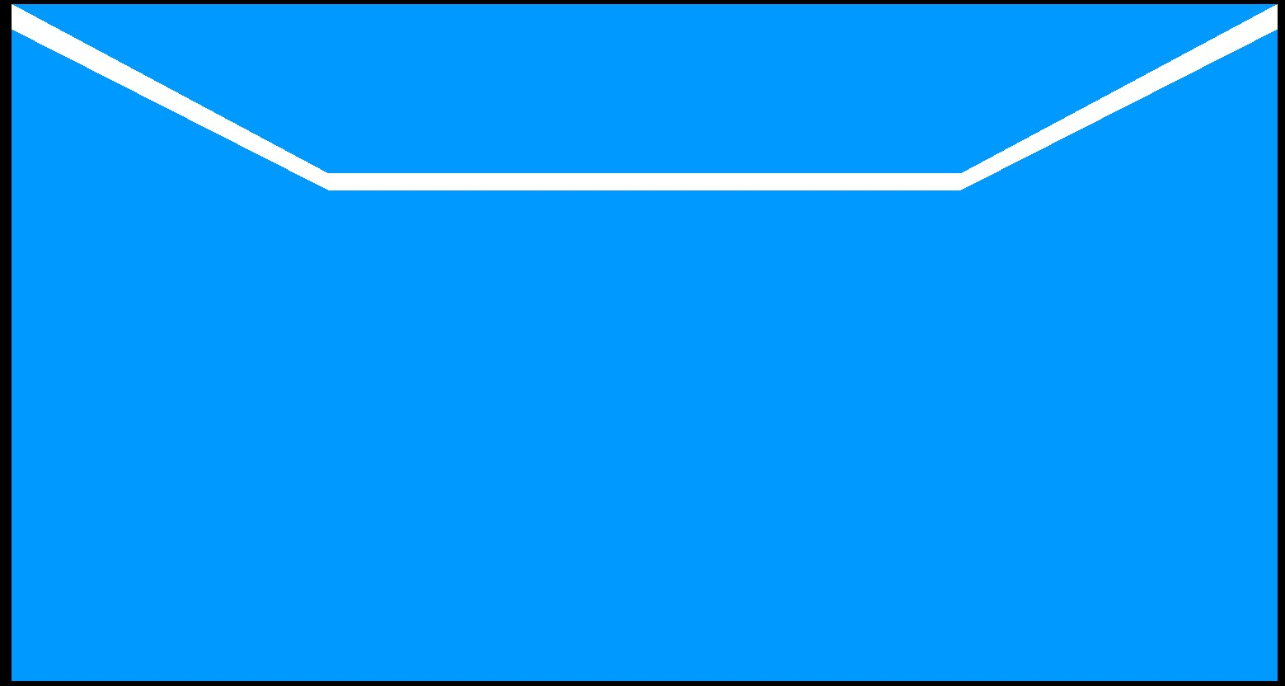
Border Top Preview

Slide 11
Code For Border Bottom
* Border Start down Start*/
glColor3f (1.0, 1.0, 1.0);
glBegin(GL_POLYGON);
glVertex3f (0.10, 0.10, 0.0);
glVertex3f (0.30, 0.30, 0.0);
glVertex3f (0.30, 0.33, 0.0);
glVertex3f (0.10, 0.18, 0.0);
glEnd();
glColor3f (1.0, 1.0, 1.0);
glBegin(GL_POLYGON);
glVertex3f (0.30, 0.30, 0.0);
glVertex3f (0.70, 0.30, 0.0);
glVertex3f (0.70, 0.33, 0.0);
glVertex3f (0.30, 0.33, 0.0);
glEnd();
glColor3f (1.0, 1.0, 1.0);
glBegin(GL_POLYGON);
glVertex3f (0.70, 0.30, 0.0);
glVertex3f (0.90, 0.10, 0.0);
glVertex3f (0.90, 0.18, 0.0);
glVertex3f (0.70, 0.33, 0.0);
glEnd();
/* Border Start down End*/

Slide 12

Border Bottom Preview

Slide 13
Code For Table
/* Table Start Start*/
glColor3f (1.0, 1.0, 0.0);
glBegin(GL_POLYGON);
glVertex3f (0.44, 0.38, 0.0);
glVertex3f (0.56, 0.38, 0.0);
glVertex3f (0.56, 0.39, 0.0);
glVertex3f (0.44, 0.39, 0.0);
glEnd();
glColor3f (0.5, 0.5, 0.5);
glBegin(GL_POLYGON);
glVertex3f (0.44, 0.39, 0.0);
glVertex3f (0.56, 0.39, 0.0);
glVertex3f (0.57, 0.43, 0.0);
glVertex3f (0.46, 0.43, 0.0);
glEnd();
/* Table leg 1 Start*/
glColor3f (1.0, 1.0, 0.0);
glBegin(GL_POLYGON);
glVertex3f (0.46, 0.30, 0.0);
glVertex3f (0.47, 0.30, 0.0);
glVertex3f (0.47, 0.38, 0.0);
glVertex3f (0.46, 0.38, 0.0);
glEnd();
/* table leg 2 Start*/
glColor3f (1.0, 1.0, 0.0);
glBegin(GL_POLYGON);
glVertex3f (0.53, 0.30, 0.0);
glVertex3f (0.54, 0.30, 0.0);
glVertex3f (0.54, 0.38, 0.0);
glVertex3f (0.53, 0.38, 0.0);
glEnd();

Slide 14
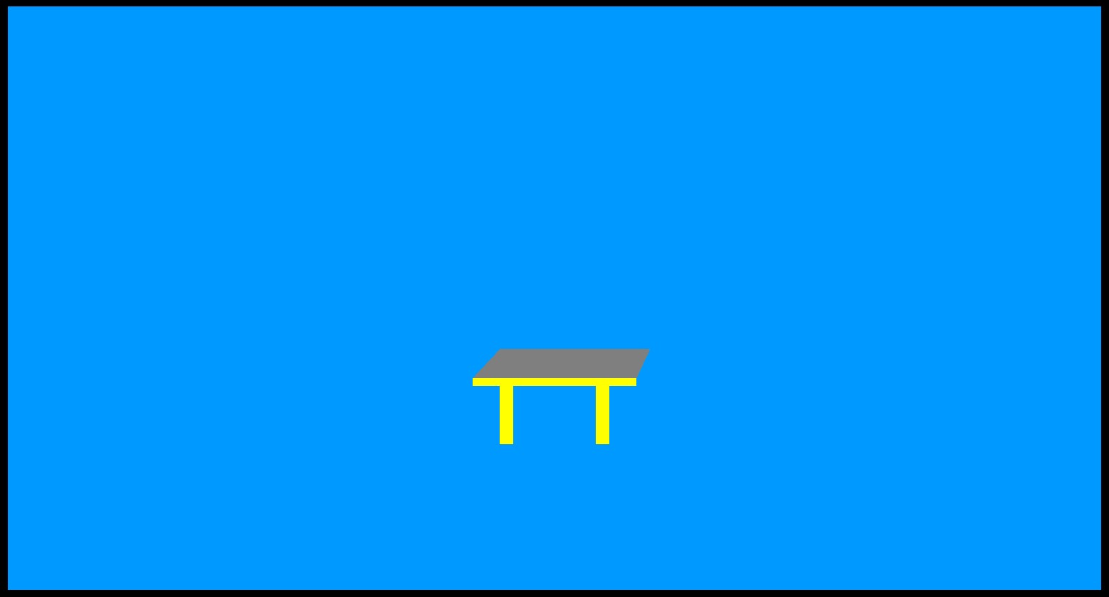
Table Preview

Slide 15
Code For Television
/* TV stand Start*/
glColor3f (0.0, 0.0, 0.0);
glBegin(GL_POLYGON);
glVertex3f (0.47, 0.39, 0.0);
glVertex3f (0.53, 0.39, 0.0);
glVertex3f (0.53, 0.40, 0.0);
glVertex3f (0.47, 0.40, 0.0);
glEnd();
/* TV Start*/
glColor3f (0.0, 0.0, 0.0);
glBegin(GL_POLYGON);
glVertex3f (0.45, 0.40, 0.0);
glVertex3f (0.55, 0.40, 0.0);
glVertex3f (0.55, 0.50, 0.0);
glVertex3f (0.45, 0.50, 0.0);
glEnd();
/* TV screen Start*/
glColor3f (0.0, 1.0, 1.0);
glBegin(GL_POLYGON);
glVertex3f (0.46, 0.41, 0.0);
glVertex3f (0.54, 0.41, 0.0);
glVertex3f (0.54, 0.49, 0.0);
glVertex3f (0.46, 0.49, 0.0);
glEnd();

Slide 16
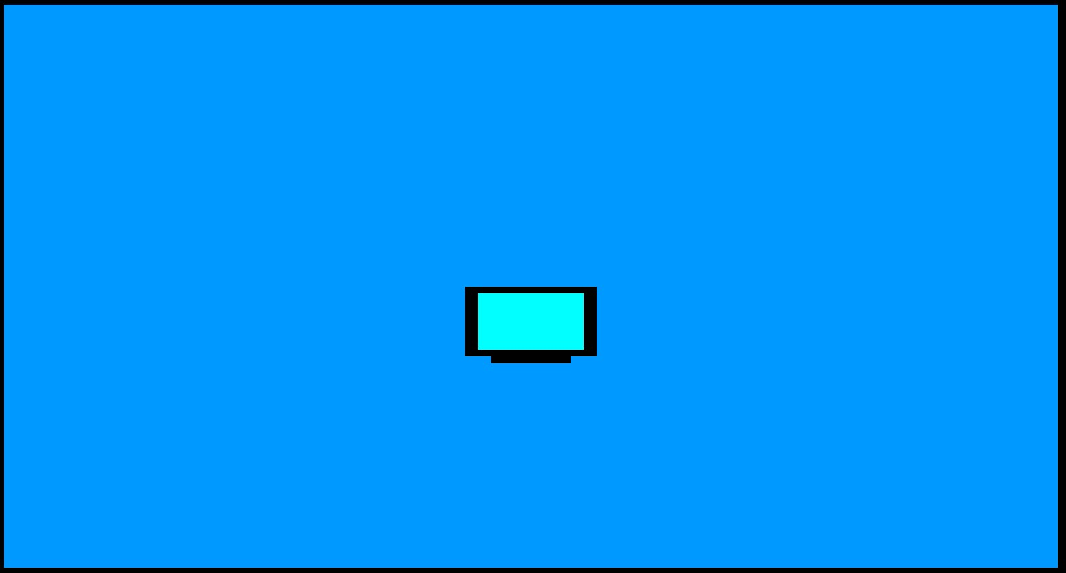
Television Preview

Slide 17
Code For Bed
/*Bed Main Start*/
glColor3f(1.0, 0.40, 1.0);
glBegin(GL_POLYGON);
glVertex3f (0.13, 0.20, 0.0);
glVertex3f (0.28, 0.19, 0.0);
glVertex3f (0.40, 0.33, 0.0);
glVertex3f (0.30, 0.33, 0.0);
glEnd();
/*Bed side Start*/
glColor3f (0.5, 0.5, 0.5);
glBegin(GL_POLYGON);
glVertex3f (0.28, 0.19, 0.0);
glVertex3f (0.28, 0.18, 0.0);
glVertex3f (0.41, 0.33, 0.0);
glVertex3f (0.40, 0.33, 0.0);
glEnd();
/*Bed side 2 Start*/
glColor3f (0.5, 0.5, 0.5);
glBegin(GL_POLYGON);
glVertex3f (0.13, 0.19, 0.0);
glVertex3f (0.28, 0.18, 0.0);
glVertex3f (0.28, 0.19, 0.0);
glVertex3f (0.13, 0.20, 0.0);
glEnd();
/*Bed leg 1 Start*/
glColor3f (0.5, 0.5, 0.5);
glBegin(GL_POLYGON);
glVertex3f (0.14, 0.19, 0.0);
glVertex3f (0.14, 0.14, 0.0);
glVertex3f (0.15, 0.14, 0.0);
glVertex3f (0.15, 0.19, 0.0);
glEnd();

Slide 18
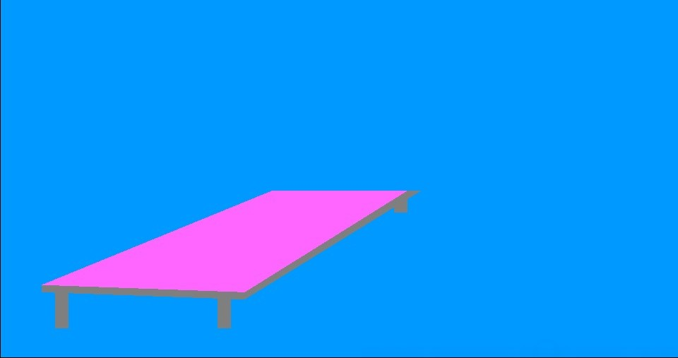
Code and Preview
/*Bed leg 2 Start*/
glColor3f (0.5, 0.5, 0.5);
glBegin(GL_POLYGON);
glVertex3f (0.26, 0.19, 0.0);
glVertex3f (0.26, 0.14, 0.0);
glVertex3f (0.27, 0.14, 0.0);
glVertex3f (0.27, 0.19, 0.0);
glEnd();
/*Bed leg 3 Start*/
glColor3f (0.5, 0.5, 0.5);
glBegin(GL_POLYGON);
glVertex3f (0.39, 0.31, 0.0);
glVertex3f (0.39, 0.30, 0.0);
glVertex3f (0.40, 0.30, 0.0);
glVertex3f (0.40, 0.32, 0.0);
glEnd();

Slide 19
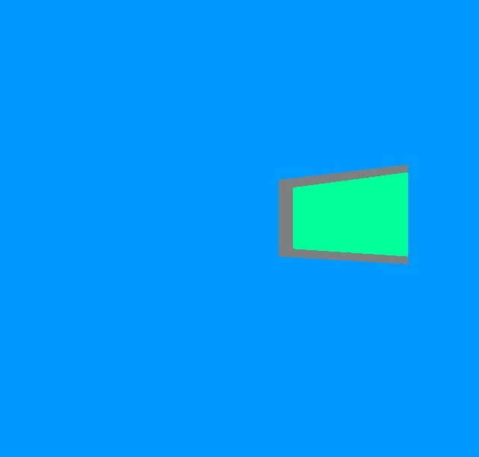
Code and Preview
/* Window Start*/
glColor3f (0.5, 0.5, 0.5);
glBegin(GL_POLYGON);
glVertex3f (0.76, 0.46, 0.0);
glVertex3f (0.85, 0.45, 0.0);
glVertex3f (0.85, 0.58, 0.0);
glVertex3f (0.76, 0.56, 0.0);
glEnd();
glColor3f(0.0f,1.80,0.60);
glBegin(GL_POLYGON);
glVertex3f (0.77, 0.47, 0.0);
glVertex3f (0.85, 0.46, 0.0);
glVertex3f (0.85, 0.57, 0.0);
glVertex3f (0.77, 0.55, 0.0);
glEnd();
/* Window Start End*/

Slide 20
Project Output

Slide 21
Thank you!
Thank you!

